Slide 1
There are time critical applications where delayed output may cause huge loss in capital or threaten lives.

Slide 2



Our ML based solution is to reduce the overall execution time. It utilizes a more appropriate processor that yields less execution time.

Slide 3

How does our solution work?
Trained ML models predicts the optimum processor for execution.
We are using XgBoost ML algorithm.
Attributes
Processor
Decision
Notes:
Here is the flow of our solution.
Trained ML models predicts the optimum processor for execution.
programmers can determine what are the features need to be concerned for the ML prediction.
We are using XgBoost ML algorithm.
XgBoost uses weak learners behind.
So, it has good performance, with less dataset.

Slide 4
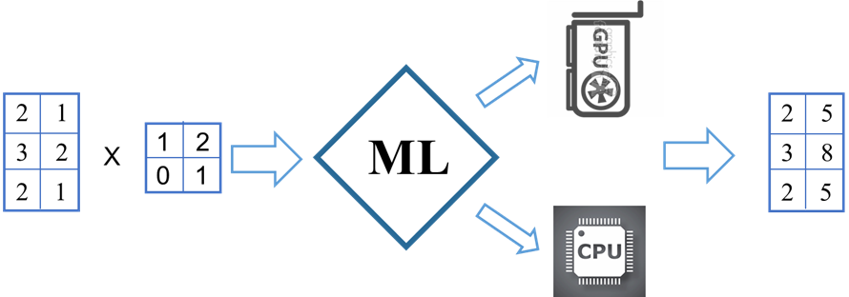
Example:
Matrix Multiplication Estimation
Notes:
Each computation instance is estimated independently with some parameters of the instances.
For example, Consider the matrix multiplication as a computational problem.
If it is required to multiply a 3x2 matrix and 2x2 matrix, 3,2,2 are the features.
Hence, the attributes of these matrixes will be feed into the ML model for the prediction of the optimal processor.
If the prediction from ML model is CPU, then this matrix multiplication will be executed in CPU.
If the prediction from ML model is GPU, then this matrix multiplication will be executed in GPU.
It is not limited to the computational models.
It can work with any computation that can earn benefit from a CPU but typically executed in a GPU forever.

Slide 5
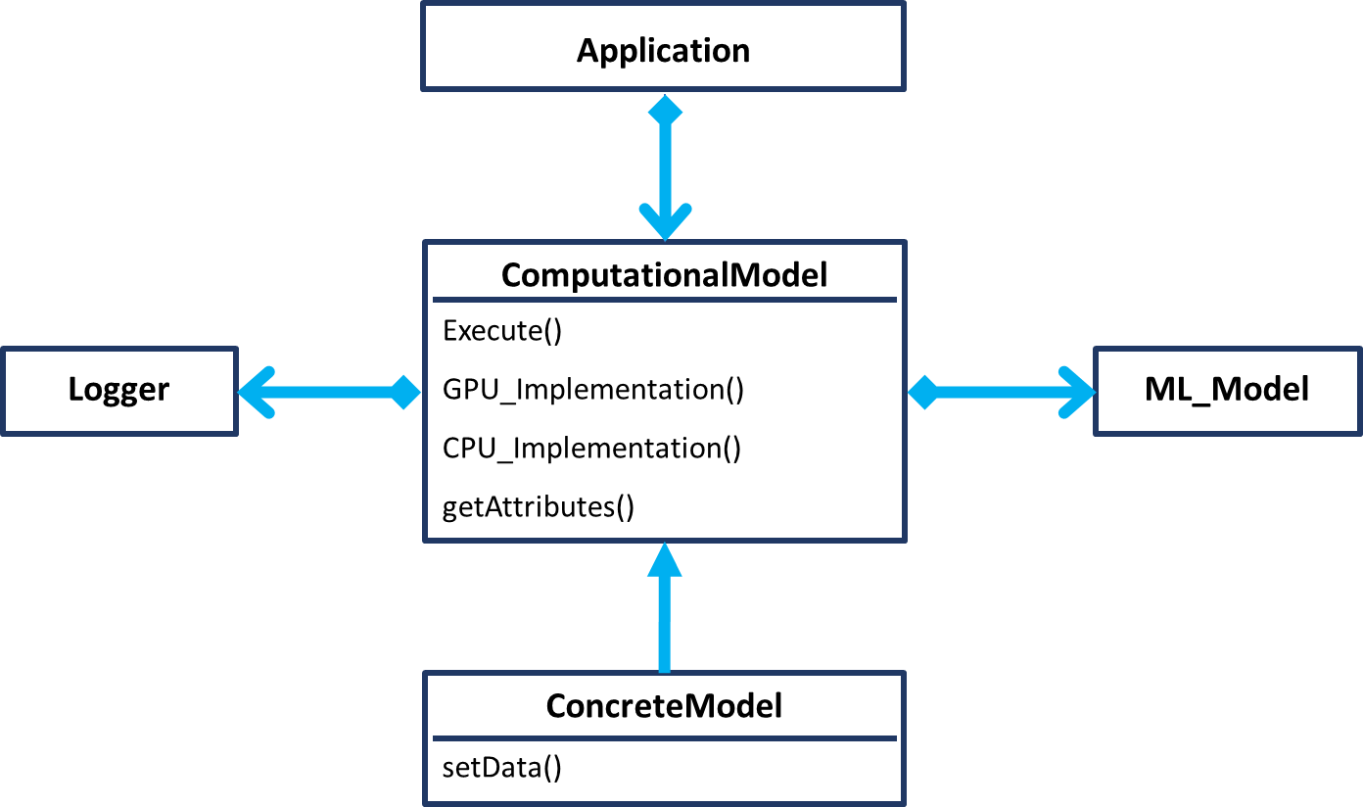
Class Diagram
Notes:
This is the class diagram of our library’s primary component.
We have a blueprint of computations called computational models.
Programmer would,
Set data to the model and .
Invoke the execute method.
This framework would,
Evaluate the computation instance.
Execute the computation on an appropriate processor.
The evaluation part is completely up to trained ML predictors.
It has a main abstract class called computational model, that evaluates the problems before execution.
And. the concretes models representing the CPU GPU implementations, of the computational algorithms to be solved.
The computational model class has three abstract methods. GPU CPU implementations and the get attributes.
Programmers can implement the methods, to create new concrete models.
When programmer calls the execute method, It estimates the task with the characteristics received from the get attributes method.
And it invoke on the appropriate processor internally.

Slide 6
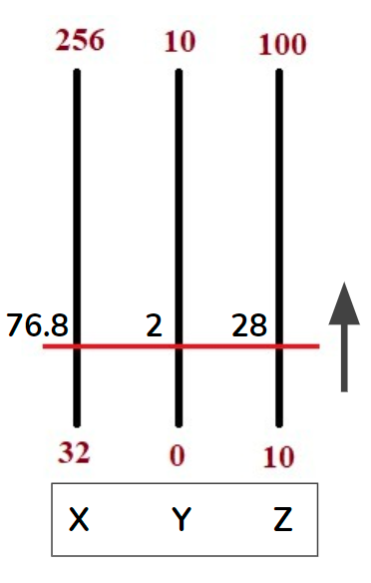
Center Boundary
Notes:
to reduce the prediction time, we are using a strategy called, Center Boundary.
The boundary is a line that straightly bisects the features.
First, we scan the training dataset and find out minimum, maximum and ranges of the features.
We increment the boundary values from the minimum to the maximum by hoping over them.
For each hop, we check whether all entries in the dataset are bisected by the line.
If so, we set it as the boundary for the moment and go for the next iteration.
Hence, the largest boundary value that bisects all entries will be retained finally.

Slide 7
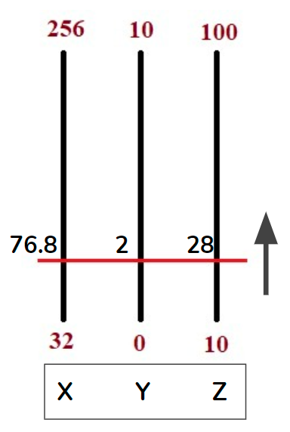
Prediction Process
Dataset
Trained Models
Train or Load
getAttributes()
= <80, 8, 40>
Attributes crosses
Boundary
Trained ML
Model
Attributes separated by Boundary
GPU | CPU
Notes:
Received attribute set first evaluated against center boundary.
When an attribute set above the boundary, it returns GPU.
Similarly, if the attribute set is below the boundary, it returns CPU.
For other cases where the attribute set crosses the boundary, we get prediction from the ML model and return it.

Slide 8
Proof of Effectiveness
Test cases | CPU | GPU | ML | Accuracy
Matrix multiplication | 129892 | 94768 | 86431 | 97 %
Blur model | 237295 | 22081 | 19411 | 95 %
Complex model | 126773 | 109982 | 97063 | 99 %
Machine 1
6 cores @2.6 GHz
8GB memory
GPU - GTX 1650
4GB / 896 cores
AWS Server
8 cores @2.5 GHz 16 vCPUS
64GB memory
GPU - Nvidia T4
16 GB / 2560 cores
Machine 2
4 cores @ 2.5 GHz
8 GB memory
GPU - GTX 1050
2 GB / 768 cores
Test cases | CPU | GPU | ML | Accuracy
Matrix multiplication | 44057 | 7620 | 6751 | 75.5 %
Blur model | 76376 | 6007 | 5679 | 87.0 %
Complex model | 27549 | 8868 | 7714 | 69.0 %
Test cases | CPU | GPU | ML | Accuracy
Matrix multiplication | 25848 | 14730 | 12188 | 87.5 %
Blur model | 171658 | 9710 | 8048 | 89.5 %
Complex model | 45848 | 21918 | 17874 | 82.0 %
Notes:
This shows the proofs that our solution is effective on three different machines.
for three computational models, it has achieved significant gain and accuracy.
Our solution has been experimented on two local machines and a machine on cloud.

Slide 9
Thank you
Notes:
Thank You

